Slide 1
How to Release funds on a PAID Expense

Slide 2
Once Your Expense (Travel , Citicard, Meals, Etc) show PAID
you can release the remaining funds back to your budget.
The funds should show within minutes.
Make sure the Expense square shows PAID …
or it will release all your funds and your Expense will NOT be paid.

Slide 3
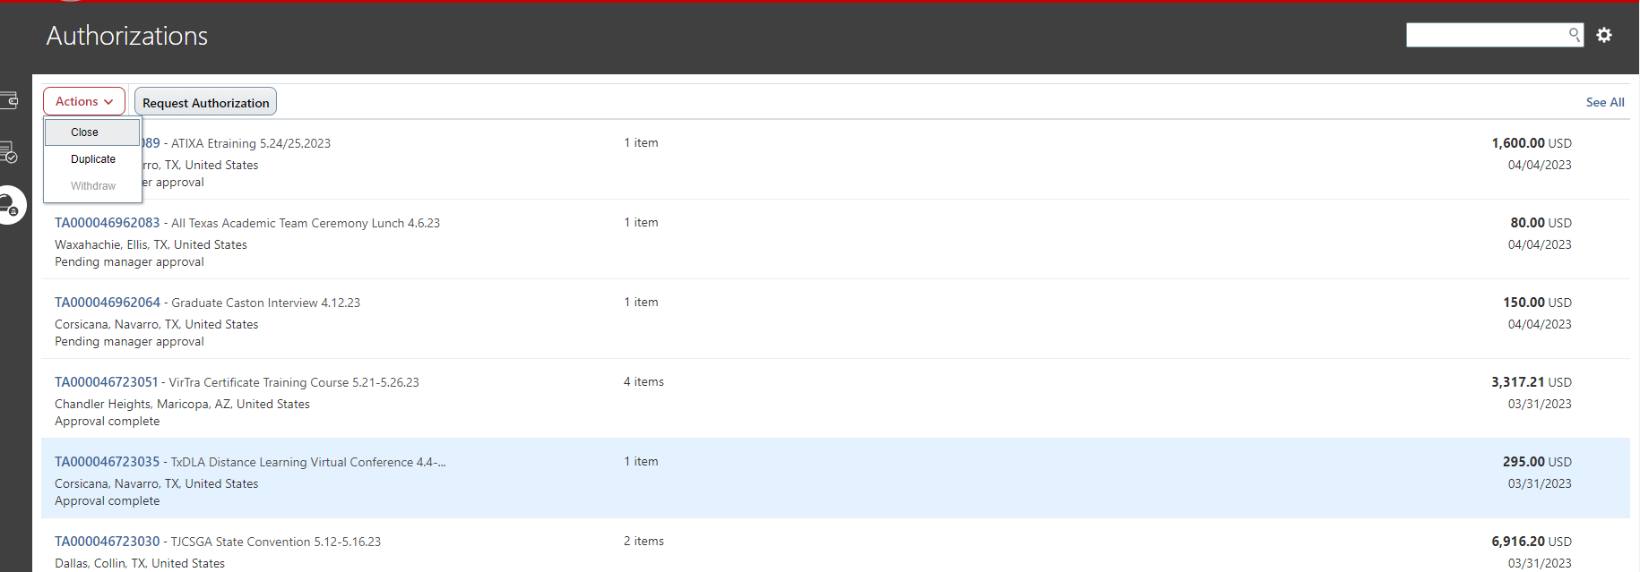
Step #1 – Go to Request Authorization Page (ME – EXPENSE – SNOWGLOBE)
Step #2 – Click on the LINE you want to close (turn it blue) - Make sure it was PAID first!
Step #3 – Click on Actions – top right of screen
Step #4 – Click on Close

Slide 4
Find your TA Expense
On the right it will say closed
On the Left is will show the amount of funds released back to your budget and the amount used for your TA Expense
This TA Expense had $152.69 released back into the budget

